Slide 1
Key Point-Based Driver Activity Recognition
Arpita Vats, David C. Anastasiu
Santa Clara University

Slide 2
Introduction
Driver activity recognition.
Provided with videos of 5 different drivers performing the 18 activities.
we present a key point-based activity recognition framework, named KNDAR

Slide 3
Methodology
Movement of key points on their body.
Pre-trained pose estimation model to identify key points.
Merge algorithm to identify distraction in driver.
School or Department, Arial 14 pt.

Slide 4
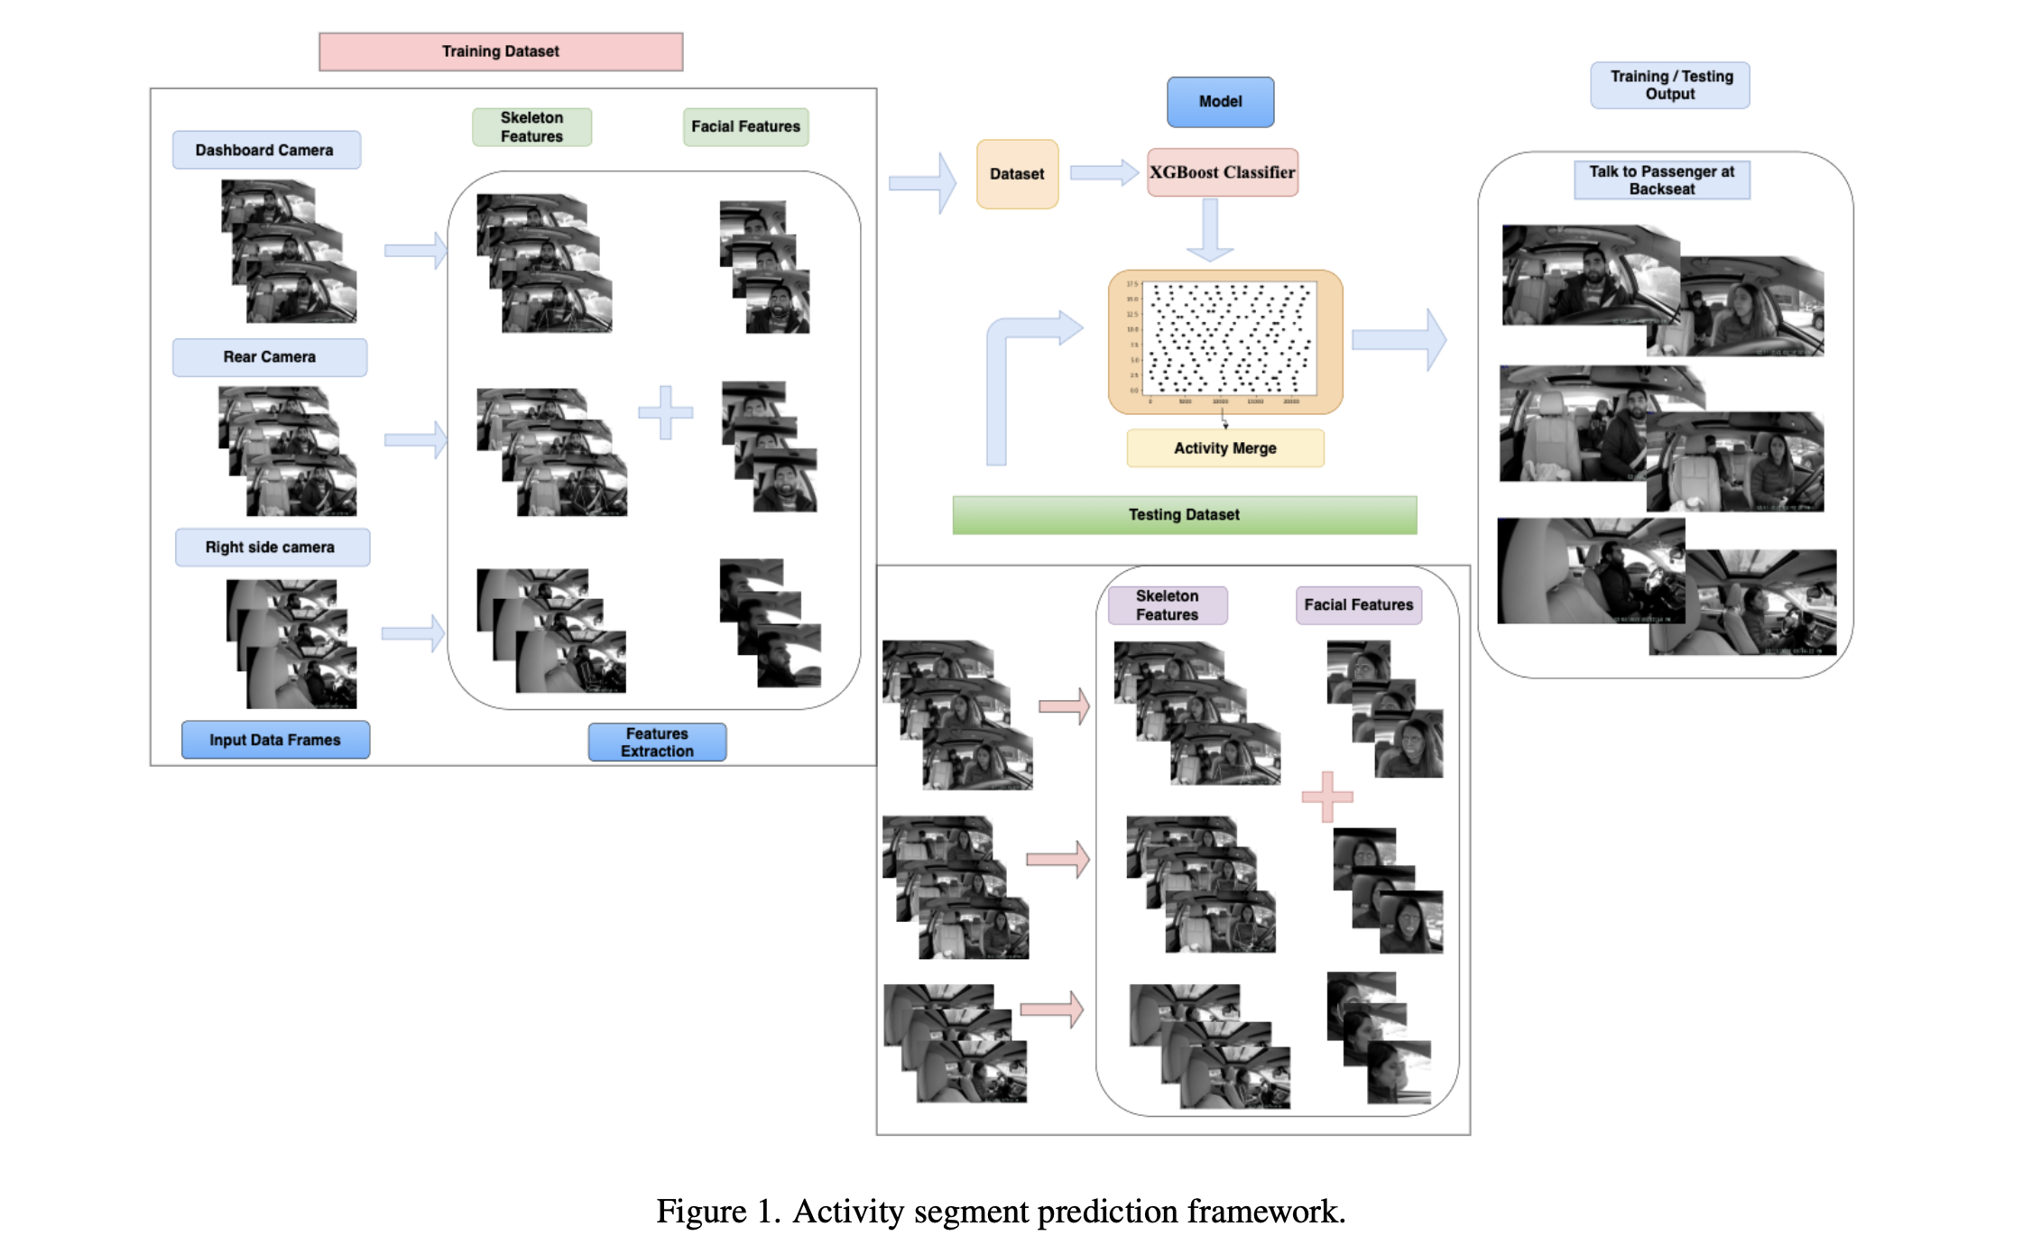
Proposed Method
School or Department, Arial 14 pt.

Slide 5
Merge Algorithm
Sorted List of class predictions is given as input.
Combining the individual per-frame predictions of the activity classification model into segments .
Looks for classes having higher percentage of predictions than expected.
Maximal consecutive class segments of length of at least minlen are added to the result
School or Department, Arial 14 pt.

Slide 6
Proposed Method
Driver Identification:-
  Pre-trained human pose estimation model to detect humans in the video.
  We used KAPAO model for feature extraction
  Our method extracts various features like angle, distance, Positions, Positions Shifts, Angle shifts, Facial Features.
  Frame Activity Classification:-
    Framework uses the features extracted from frames
    XGBoost (eXtreme Gradient Boosting)
    Segment activity classification :-
      Merge algorithm to identify activity segments
      maximal consecutive class segments of length of at least min len are added to the result set
School or Department, Arial 14 pt.

Slide 7
Experimental Results
    Feature Extraction
      We extracted features from dashboard (dash), rear view mirror (rear), side window (side), or all camera views
      we executed experiments using 24 different feature sets
      Frame Activity Classification
        We split training set and validation set in ratio of 80:20
        Trained using XG Boost models.
        F1 score with facial feature – 0.9548, F1 score without facial feature – 0.9662.
        We were ranked 11 Position in AI CITY Challenge on the public leaderboard.
        Segment Activity Classification
        Merge Algorithm for segment activity classification
School or Department, Arial 14 pt.

Slide 8
Conclusion
    We use pre trained human pose estimation model and facial feature detection.
    Extracting movement based feature from key frames in videos.
    Classification model to identify the potential action.
    Merges sequence of action prediction.
School or Department, Arial 14 pt.

Slide 9
Future Works:
    Object detection using yolov5.
    Improve the driver identification algorithm.
Improve merge algorithm; specifically, it should not rely on challenge activity statistics.
School or Department, Arial 14 pt.

Slide 10
Thank You

